Slide 1



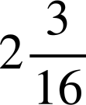

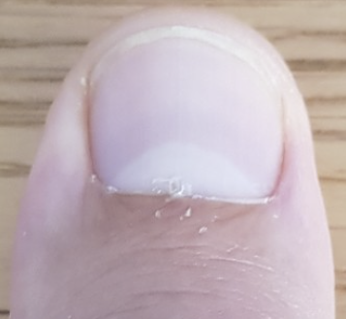
Engineer
Task A: Precision in engineering
1) Read these measures.
inches
a)
0
in
1
2
3
inches
inches
b)
0
in
1
2
3
c)
0
in
1
2
3
2) Use a rule of thumb to measure out the below:
a) One and three eighths of an inch.
b) Two and three sixteenths of an inch.
1
2
2
3

Slide 2
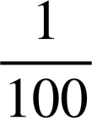
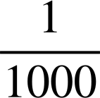
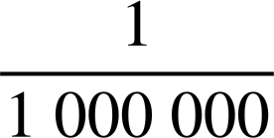
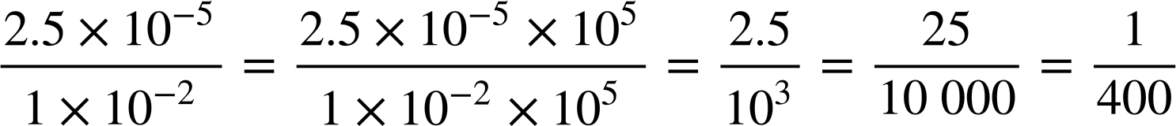
Engineer
3) a) How many millimetres in a centimetre?
One centimetre
m
1 × 10⁻² m
10
One millimetre
m
1 × 10⁻³ m
b) How many micrometres in a millimetre?
One micrometre
m
1 × 10⁻⁶ m
(1 × 10⁻³) ÷ (1 × 10⁻⁶) = 1000
c) How many micrometres in a centimetre?
(1 × 10⁻²) ÷ (1 × 10⁻⁶) = 10 000
d) Engineers can laser cut to a precision of 2.5 × 10⁻⁵ m
What fraction of a centimetre is this?
Can you imagine one four-hundredth of a centimetre! This is the kind of precision engineers operate to.
Task B: Other applications of maths
1) Show whether each of these walls is upright.
a)
b)
c)
3² + 4² = 5²
5² + 12² = 13²
50 cm
40 cm
13 yd
5 ft
12 yd
4 ft
Right
Right
Right
30 cm
3 ft
30² + 40² = 50²
5 yd

Slide 3



Engineer
2) Explain how we know this corner is not ‘right’.
You might have said, “In order to be ‘right’ the Mason’s Rule should ‘fit’ to the points measured at 3 ft and 4 ft to make a ‘right’ 3, 4, 5 triangle”.
✖
“Because the rule does not ‘fit’ here we know the third length is not 5 ft therefore this is not a right-angled triangle; the corner is not a right angle.”
5 ft
✖
3 ft
4 ft
3) Engineers today use Pythagoras to calculate lengths. Find all the missing lengths of the girders on this bridge. The design is symmetrical.
24 m
10 m
26 m
26 m
48 m
12 m
15 m
12 m
32.3 m
12 m
15 m
12 m
32.3 m
9 m
30 m
9 m
Mathematics in Education and Industry
v2.4

